Slide 1
CREDIT CARD SPENDING PREDICTION
GREYATOM HACKATHON

Slide 2
PROBLEM STATEMENT
Predict the average credit card spend of the customer for coming three months.

Slide 3
POTENTIAL BUSINESS PROBLEM
It is very important for Customer Relationship Management in Banking Sector to understand the consumption pattern for credit cards at an individual consumer level.

Slide 4
Why solve this Problem?
This Understanding allows banks to customize for consumers and make strategic marketing plans. Thus it is imperative to study the relationship between the characteristics of the consumers and their consumption pattern.

Slide 5
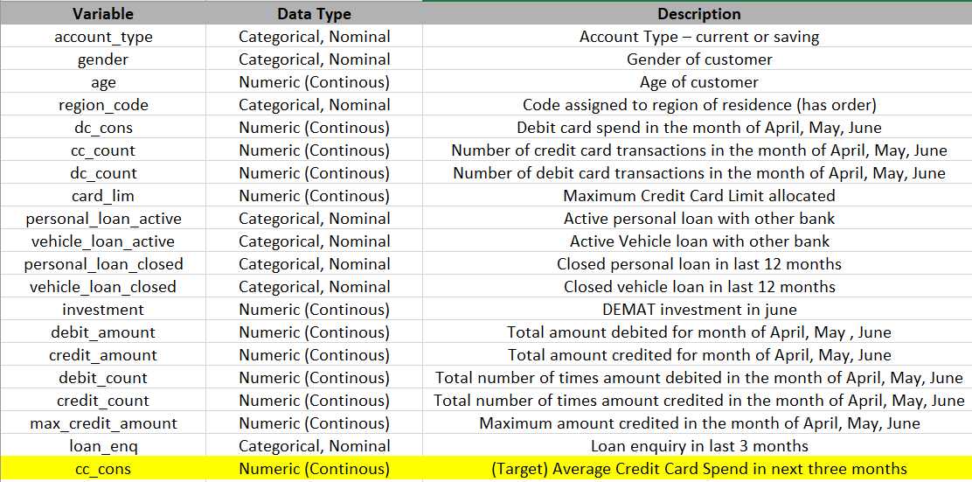
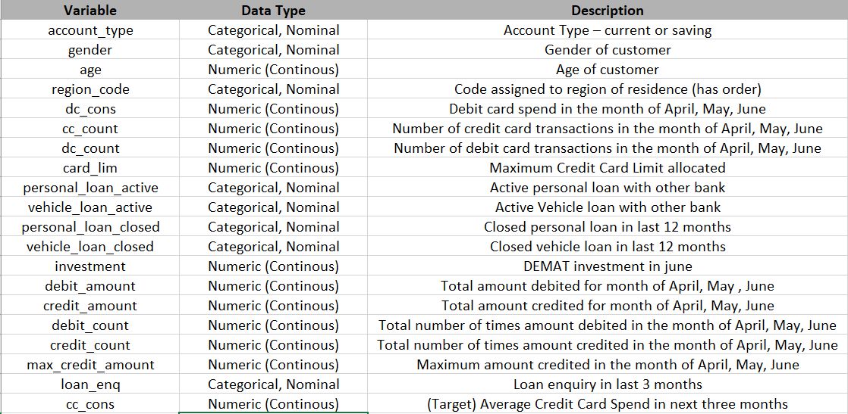
DATA
Dataset Information : The data consist of records of 15000 Customers and 39 Features. There are 38 predictors and 1 Target (i.e. cc_cons ) that shows the customers spending for next three months.

Slide 6
EVALUATION METHOD
The evaluation metric for this project is RMSE

Slide 7
Exploratory Data Analysis
Are there places where people have high or low levels of spending on credit cards compared to other places where we could introduce good marketing campaigns and specific offers?

Slide 8
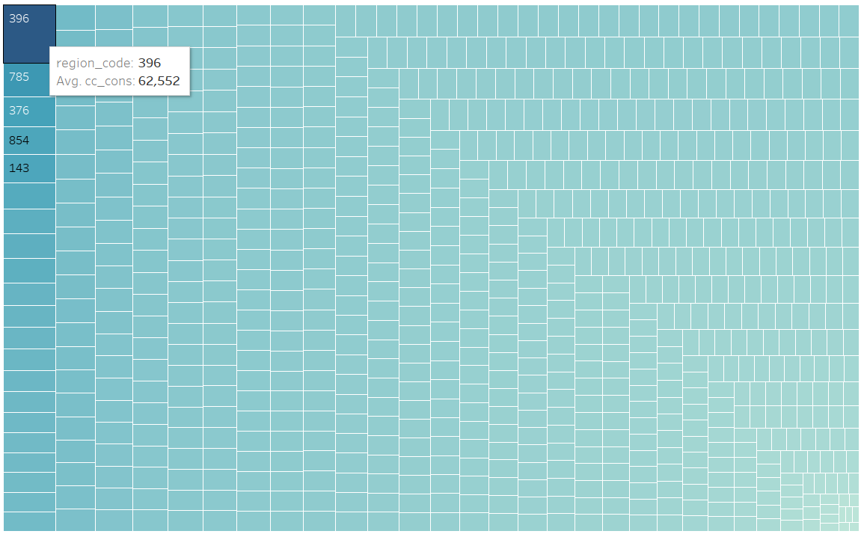



Average credit card spending around different regions.

Slide 9
Exploratory Data Analysis
Are men or women paying more on credit cards?

Slide 10
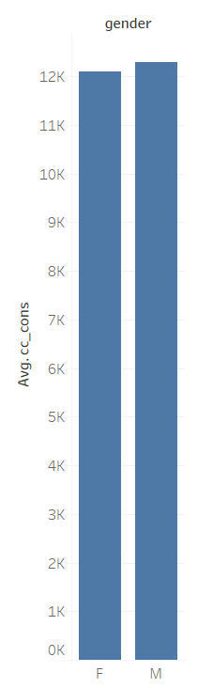


Exploratory Data Analysis
Women only spend 1.65 % less than that of men having a credit card.

Slide 11
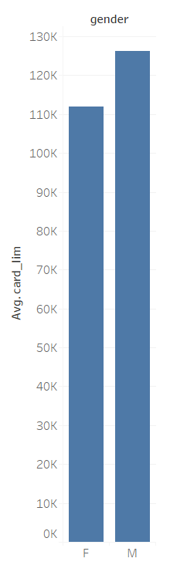


Exploratory Data Analysis
Women are having is 11% less
Average credit card limit compare to men.

Slide 12
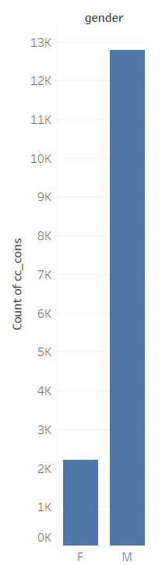


Exploratory Data Analysis
Then why there are only 14 % of the women are having a credit card.
No. of Customers

Slide 13
Exploratory Data Analysis
Let’s see how biased is credit card spending with different account types.

Slide 14
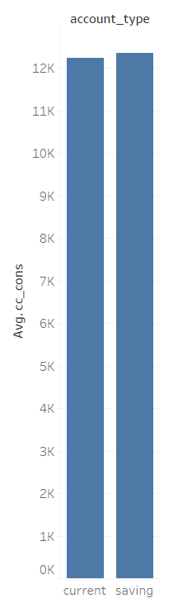
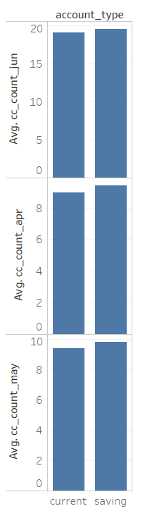
Exploratory Data Analysis
Saving account holders are having slightly higher average spending compare to other.
Even in their average number of credit card transaction they are slightly on the upper side in past 3 months .

Slide 15
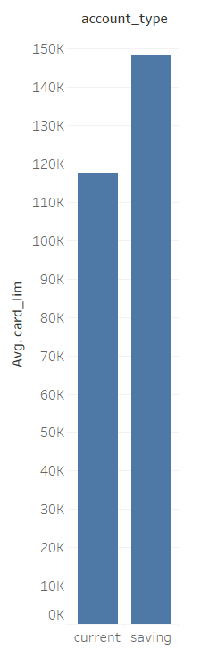
Exploratory Data Analysis
Saving account holders are having 20% more average credit card limit compare to current account holders.

Slide 16
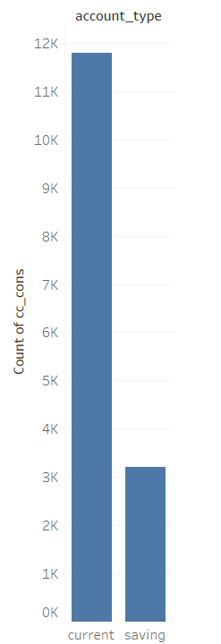
Exploratory Data Analysis
21% of people are having saving accounts, these could be because of restrictions in no. of transactions, and limitations in amount of deposit and withdrawals.
No. of Customers

Slide 17
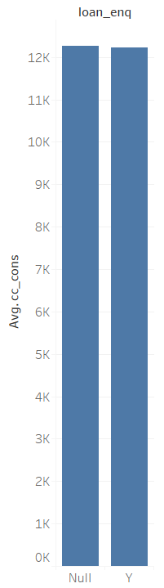
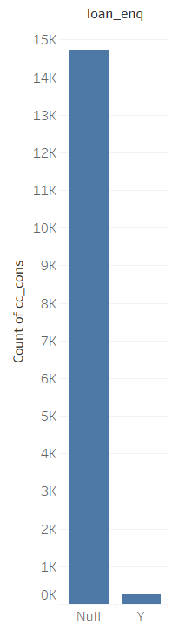
Exploratory Data Analysis
Very less number of people have enquired for loans.
But there average credit card spending not less compared to those who have not enquired.

Slide 18
PIPELINE
OUTLIER TREATMENT :
The Outliers in the continuous features were detected and treated using a method called Winsorization.
These brings our data with 15000 records to 287 records.
Our data could break records for having outliers

Slide 19
PIPELINE
MISSING VALUES :
There were too many missing values in the continuous features filled with their mean value.
There are some Categorical features with 90% and more missing values in categorical features like Personal/Vehicle Loan active and closed, DEMAT Investments, and Loan enquiry. Tried to fill with Zeros and even tried to remove it.

Slide 20
PIPELINE
FEATURE SELECTION :
There were too many missing values in the continuous features filled with their mean value.
There are some Categorical features with 90% and more missing values in categorical features like Personal/Vehicle Loan active and closed, DEMAT Investments, and Loan enquiry. Tried to fill with Zeros and even tried to delete it.

Slide 21
MODELS AND APPROACHES
Data Split :
75% Training & 25% Test Data
Modification of Target Variables :
To directly optimize the RMSE values for the models, the target function was converted to log(cc_cons+ 1). This allowed to use RMSE as optimization metric while in reality optimizing RMSLE

Slide 22
MODELS AND APPROACHES
Hyperparameter Tuning :
It was used to find best parameter for each of the following model : XGBoost, Random Forest and Linear Regression.

Slide 23
MODELS AND APPROACHES
Models | RMSE
Random Forest Regressor | 7749.721948627598
XG Boost Regressor | 400.91617154426643
Lasso Regression | 7924.246059253775
Linear Regression | 8260.305364096605

Slide 24
MODELS AND APPROACHES

Slide 25
EVALUATION & RESULTS

Slide 26
FINAL RESULTS

Slide 27
INSIGHTS & DECISIONS

Slide 28
NEXT STEP

